Slide 1
Battery

Slide 2
Battery Agenda
Back ground information
Lithium cell Model creation
Data Collection
Parameter estimation
Battery pack model creation

Slide 3
Battery Function
The battery has two main functions within this electrical circuit:
Guarantee a minimal autonomy according to the testing requirements
Act as a buffer to supply power when the power sources are unable to meet the demand from the motors and to level current peaks

Slide 4
Types of batteries
Batteries in general can be classified into two main categories:
1- Primary (non-rechargeable)
Such as: Zinc-Carbon battery, Alkaline battery and Lithium battery.
2- Secondary (rechargeable)
Such as: Lead acid, Lithium Ion, Nickel Cadmium and Nickel Metal Hydride.
Unlike car battery, deep cycle batteries that are used in renewable energy applications are meant to be discharged and recharged (cycled) repeatedly.

Slide 5
Deep Cycle Battery
Solar Batteries (Deep Cycle Batteries) are a key component in a stand-alone renewable energy system. As they accumulate excess energy created by your system and store it to be used when there is no other energy input.
Installing solar panel system tied to utility grid, will still need deep cycle batteries in case of using power in the event of an outage. Without deep cycle batteries, you can only use power at the time you produce it (i.e. you will not have power when the sun isn't out if you don't have batteries in your solar electric system).

Slide 6
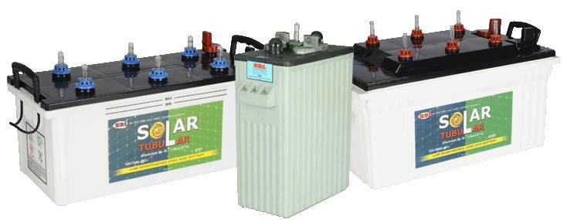
Deep cycle battery

Slide 7
Battery Descriptions
1)Rated Voltage: 12^{v} , 24^{v} and 48^{v}
2)Rated Capacity: 1,2,3,10.. Ah
3) Cycle Lifetime of the battery:
the ability of the battery to charge and discharge till 80% of the nominal capacity.

Slide 8
4) State of Charge (SOC) and Depth of Discharge (DOD):
they both are complementary to each other but SOC is normally used when discussing the current state of a battery in use, while DOD is most often seen when discussing the lifetime of the battery after repeated use.
5) “C” rate :
C-rate is the current which we use how fast the cell is charging or discharging.
1C means to allow the cell to charge/discharge in 1 hour. 0.5C means to allow the cell to charge/discharge in 2 hour. 2C mean half hour and so on.

Slide 9
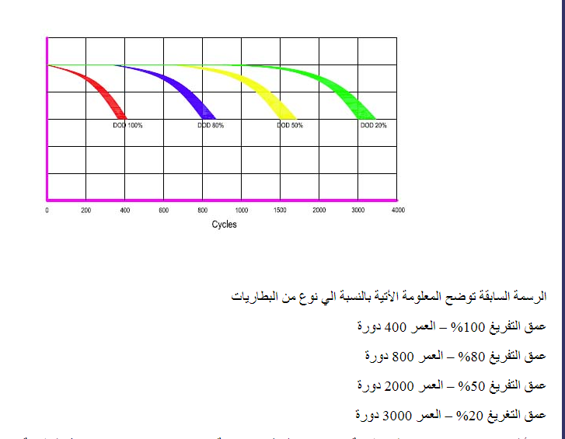
What does DOD effect?

Slide 10


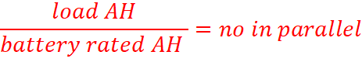
Series and parallel batteries
1-series:
2-Parallel

Slide 11
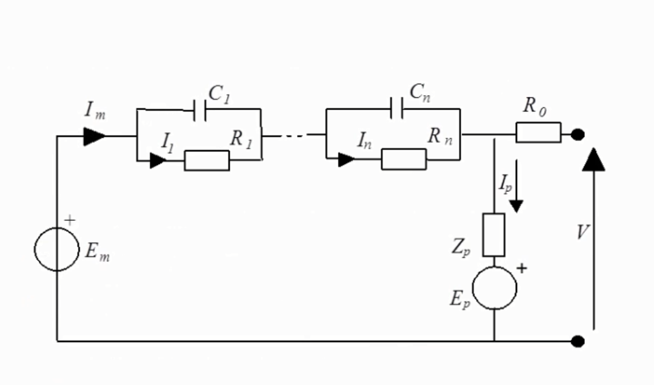
Equivalent-Circuit Cell Modeling

Slide 12
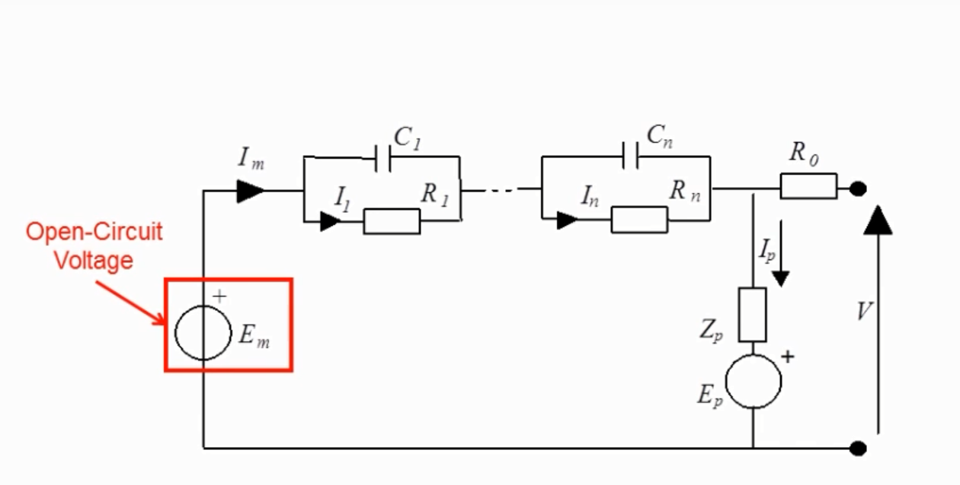
I- open circuit voltage

Slide 13
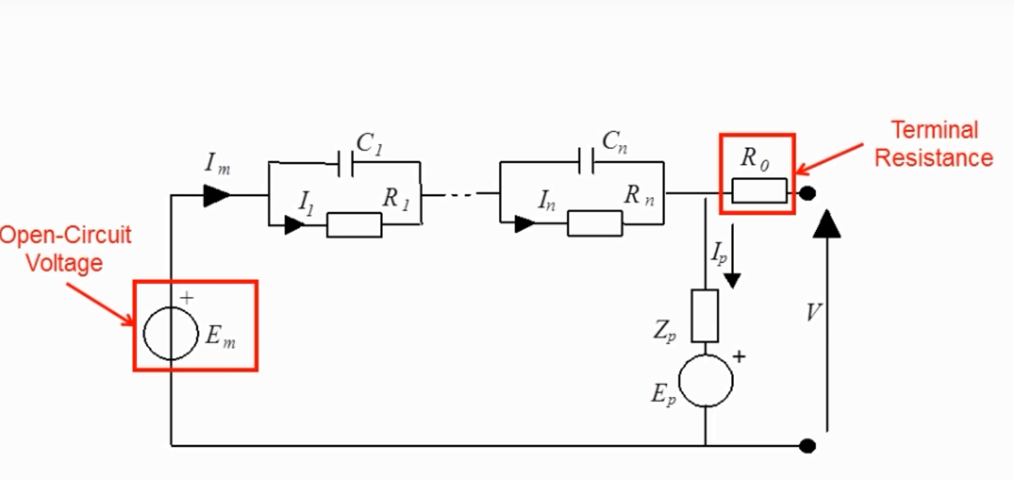
2- terminal voltage

Slide 14
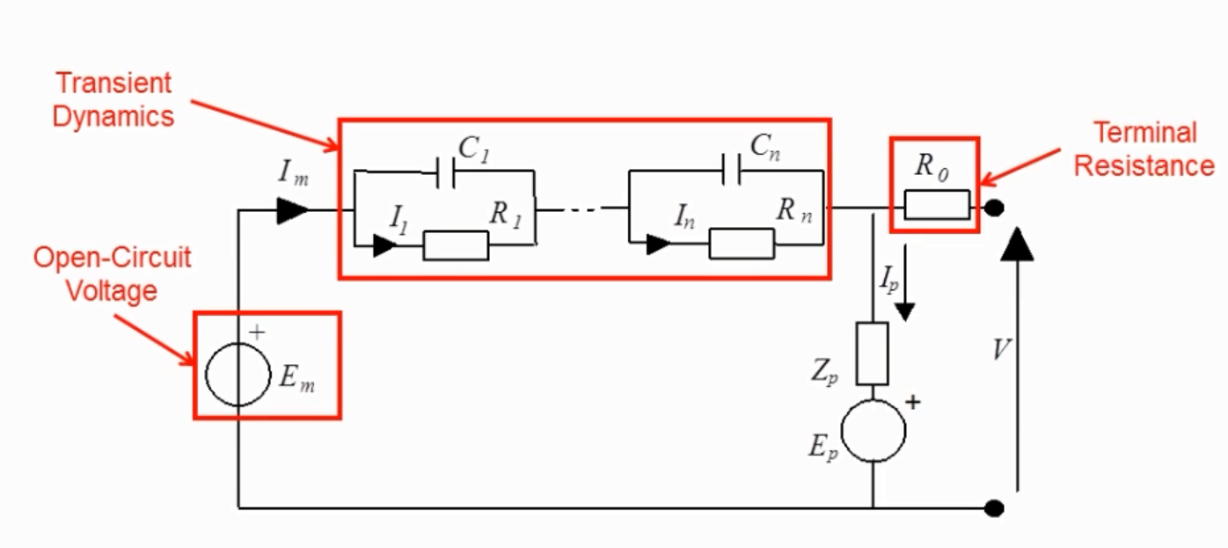
3-Transient dynamics

Slide 15
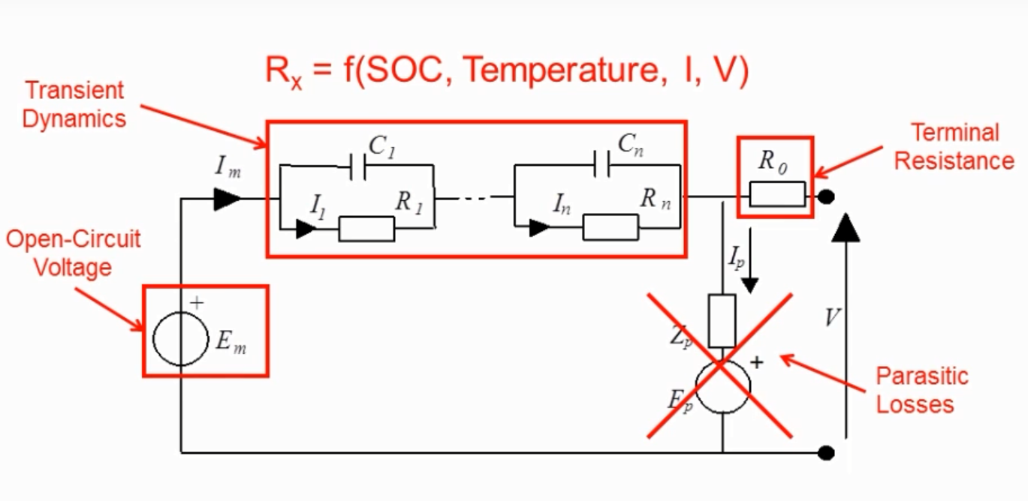
Neglect parasitic loses

Slide 16
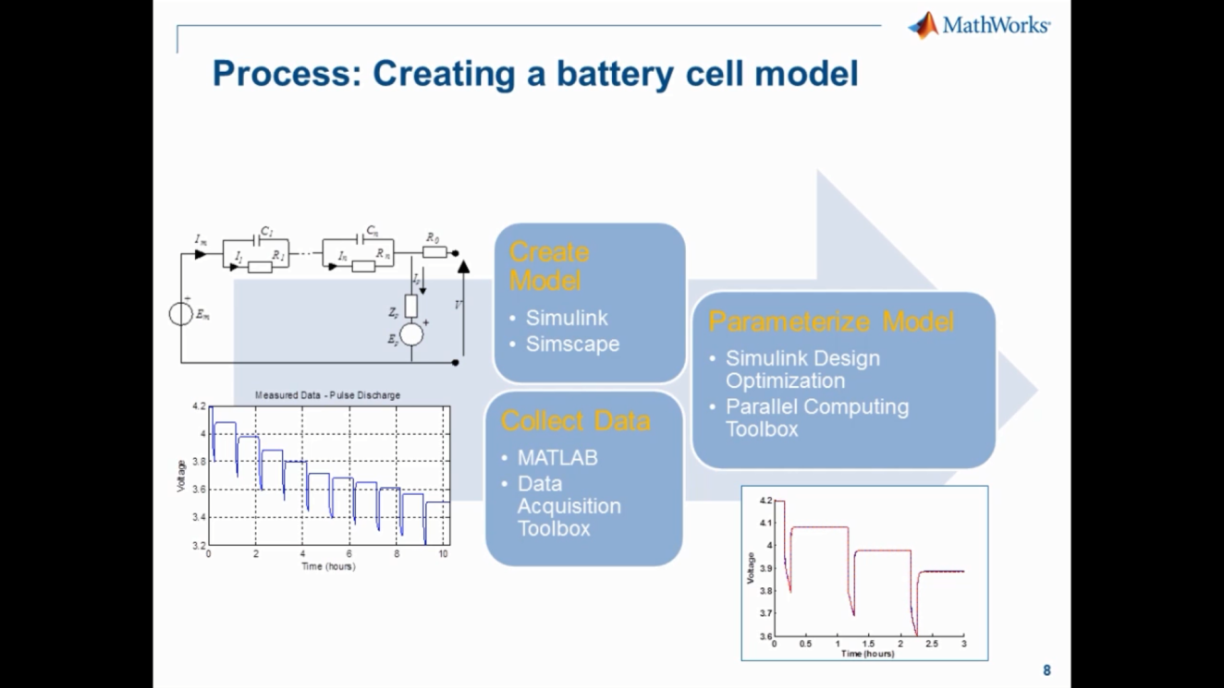
Steps of creating a battery cell model

Slide 17
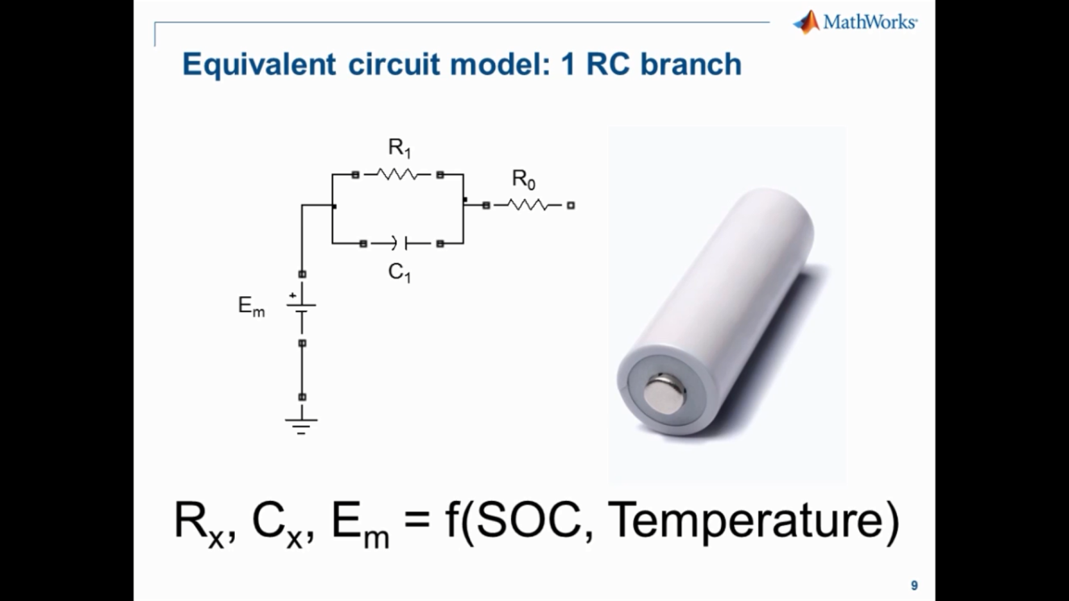

Slide 18
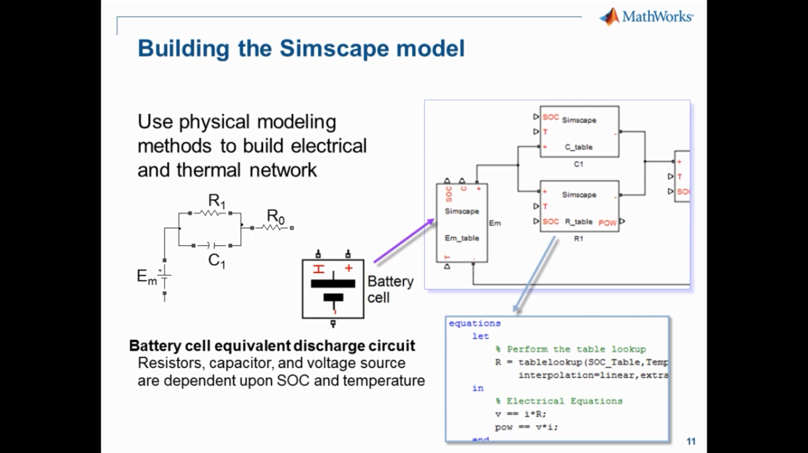
Battery model in Math lab

Slide 19
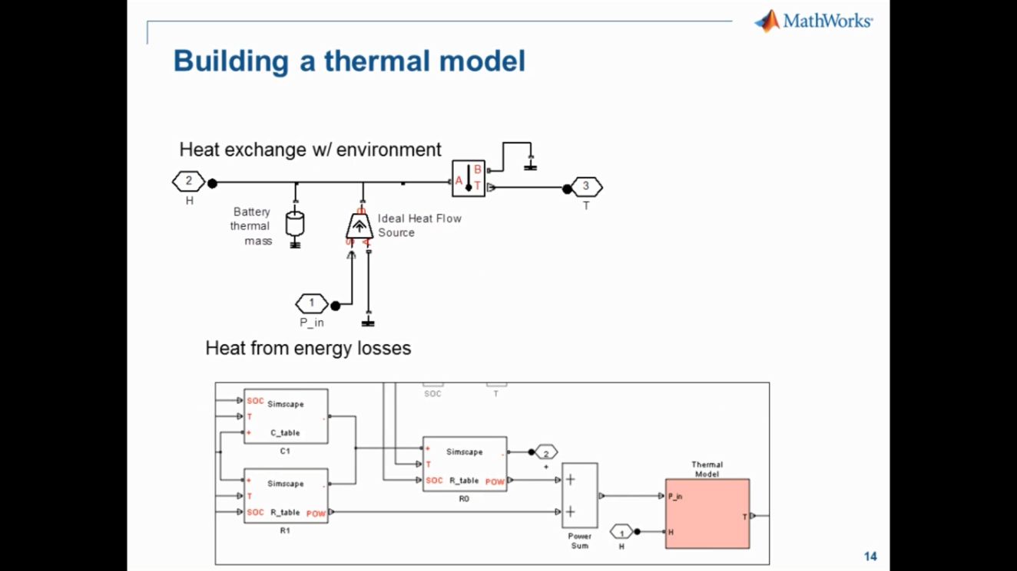
Thermo model for heat generation

Slide 20
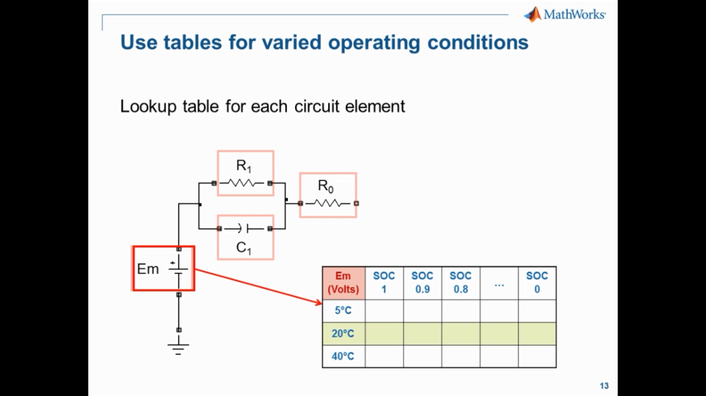

Slide 21
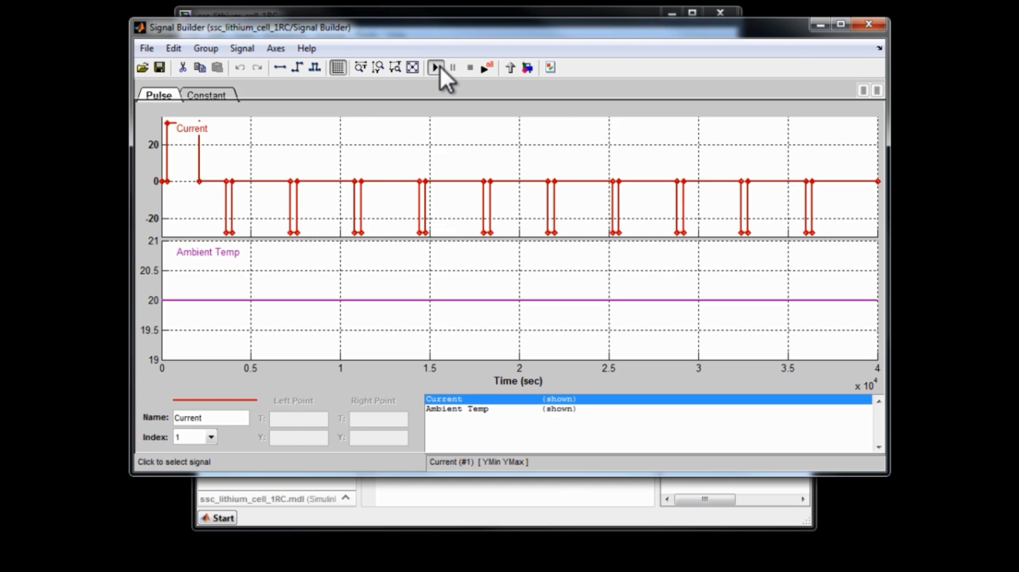
Pulse charge and discharge technique

Slide 22
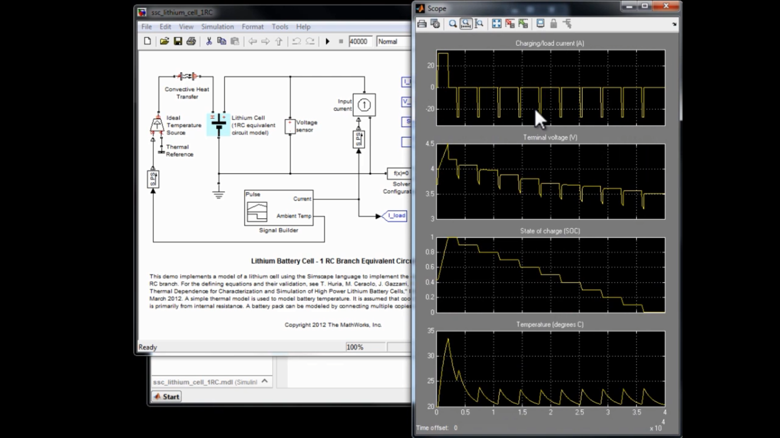
The signal pulsar scoop

Slide 23
What is data required
Relevant operation condition ranges of:
Temp
SOC
Current
Measured Data:
Constant current discharge
Pulse discharge
Pulse charge

Slide 24
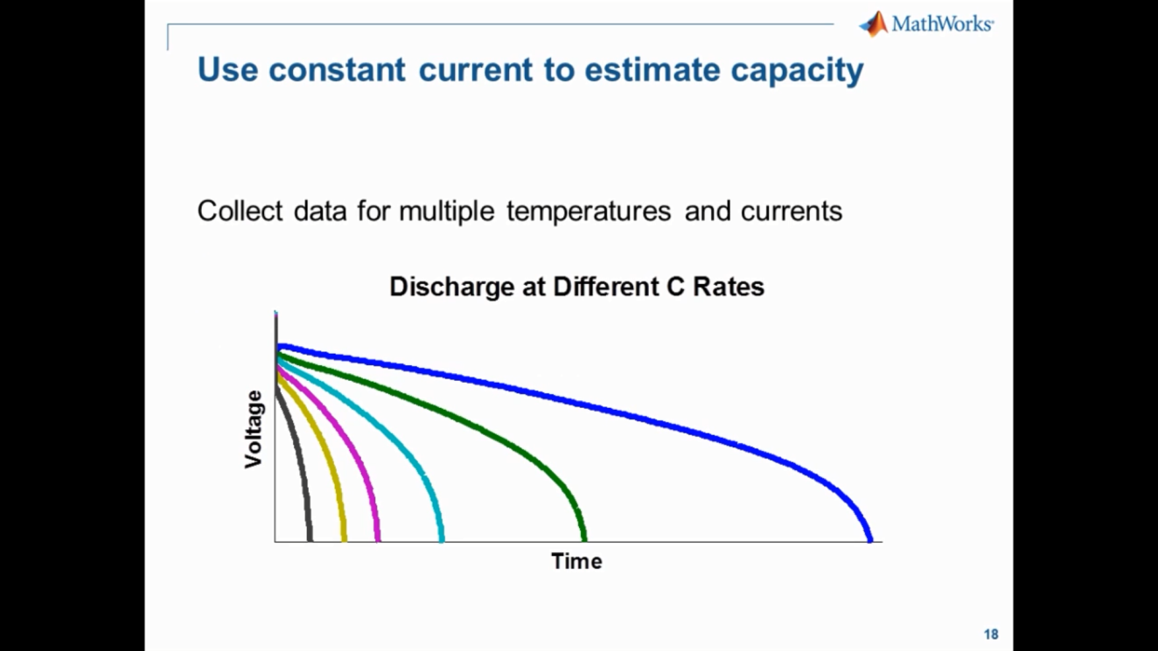
Constant current

Slide 25
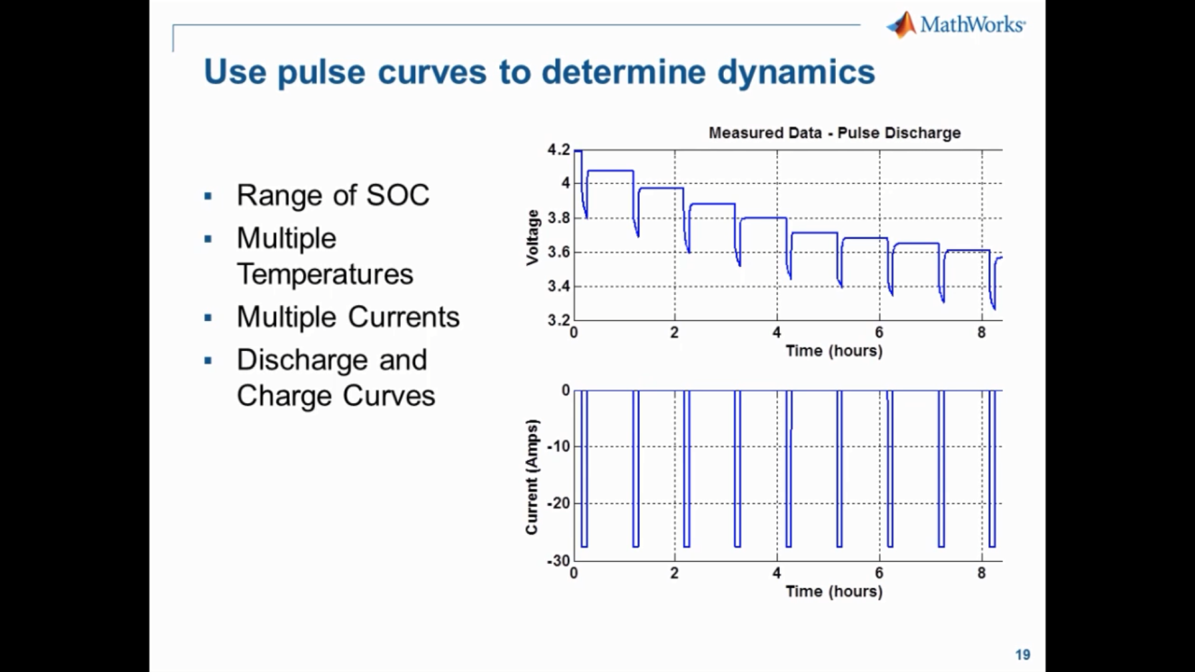
Function of the signal pulsar

Slide 26
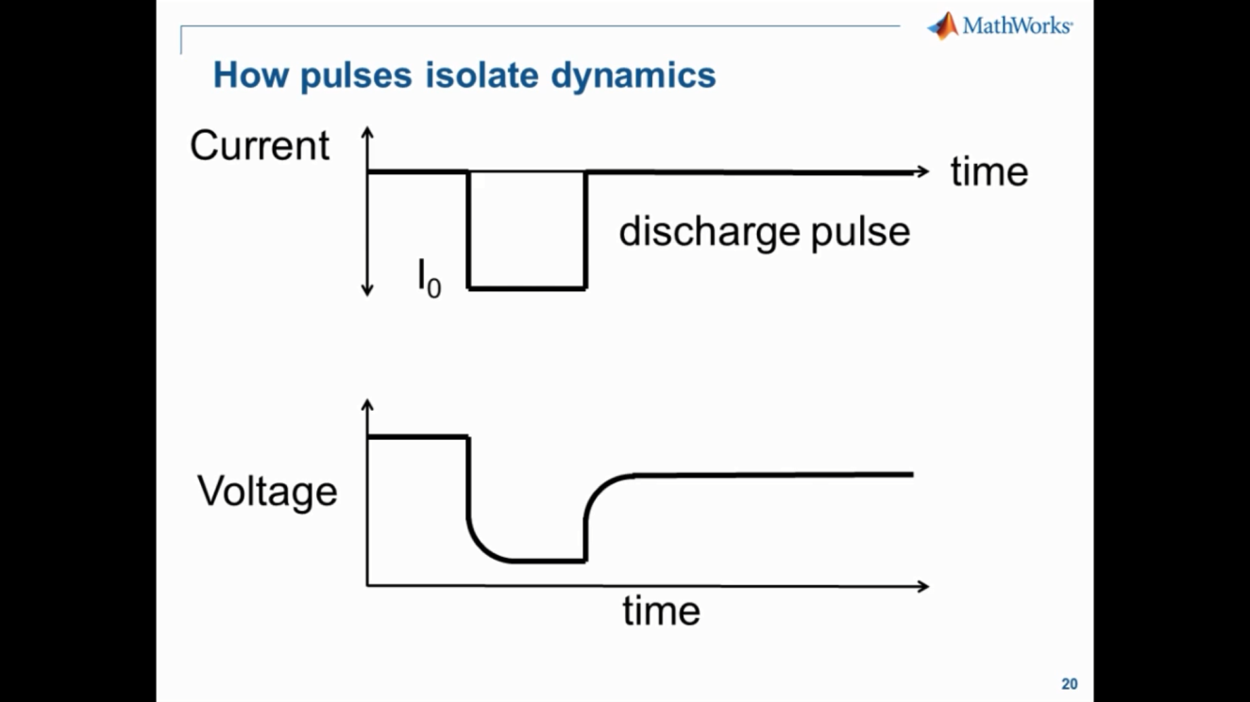
What is the transient dynamics

Slide 27
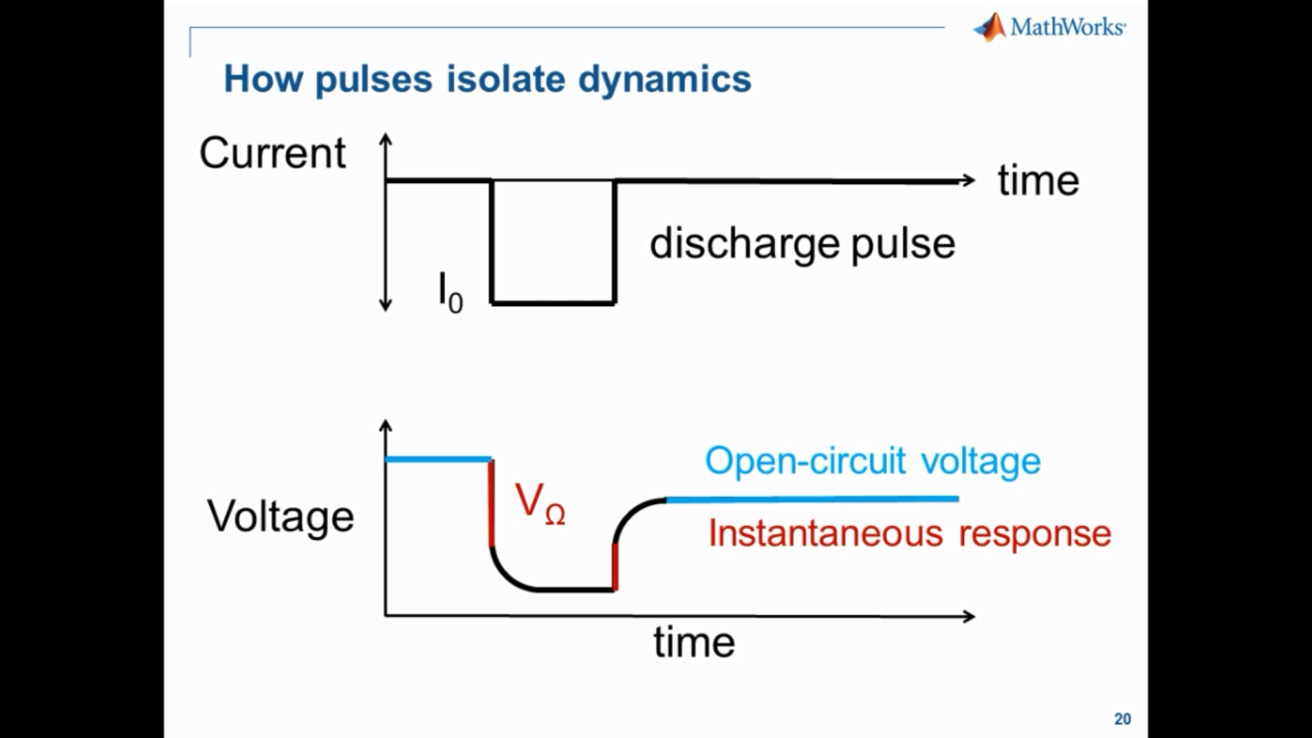

Slide 28
